Slide 1
Cellular Network Protocols & Vulnerabilities
Week 3

Slide 2
Wireless Communication Technology Generations
Our Wireless Communication Technology is categorized by generations. Each generation implements various major technological advancements.
The Generations are the following:
1G: Released in the 1980’s. These analog networks enabled basic voice calls but had limited capacity and security.
2G: Released in the 1990’s. 1G analog was phased out and replaced with digital networks. Introduced SMS.
3G: Released in the early 2000’s. Added video calling and mobile internet access.
4G: Released around 2010. Significantly increased the speeds of 3G, and supported new technologies like LTE, and VoLTE (Voice over LTE).
5G: Current. Significantly faster than 4G LTE, and can handle 100x more in traffic capacity than LTE.

Slide 3
Common Network Protocols (2G & 3G)
Code-Division Multiple Access (CDMA, or CDMAone) was used in 2G cellular networks across the United States. It then evolved into CDMA2000, which was released as a backwards compatible 3G replacement to CDMAone.
CDMA allows numerous signals to occupy a single transmission channel, optimizing the use of available bandwidth. The technology is used in the 800 MHz and 1.9 GHz bands.
Global System for Mobile communication (GSM) was a Time-Division Multiple Access (TDMA) based protocol. It was the most common 2G technology and was used globally. The 3G replacement for GSM was the Universal Mobile Telecommunications System (UMTS).
GSM digitizes and compresses data, then sends it down a channel with two other streams of user data, each in its own time slot. It operates at either the 900 MHz or 1,800 MHz frequency band.

Slide 4
Common Network Protocols (4G & 5G)
Long Term Evolution (LTE) is based off the GSM and UMTS standards. LTE is a 4th Generation (4G) standard, and is significantly faster than its 3G counterparts. Verizon and AT&T pushed LTE, while Sprint was pushing for WiMAX.
Worldwide Interoperability for Microwave Access (WiMAX) was another 4G competitor. However, WiMAX didn’t use a technique to encode digital data on multiple carrier frequencies, but LTE did. As a result, Sprint changed course and began to support LTE across its network, and WiMAX began to disappear.
5G New Radio (5G NR, or just 5G) is the latest technology that is a part of the 5th generation network. It was designed to be the global standard for the air interface of 5G networks. It is considered the successor of LTE.

Slide 5
What’s The Better Generation?
4G and 5G networks are currently the best options we have available to us. 5G being the better of the two. However, it isn’t available everywhere (yet).
As far as 2G and 3G goes:
AT&T has already shut down its 2G GSM network and most recently shut down 3G GSM/UMTS in February 2022.
T-Mobile shut down 3G GSM/UMTS in July 2022, and shut down the 3G CDMA network used by Sprint on March 31, 2022.
Verizon shut down its 3G CDMA network on December 31, 2022.

Slide 6
SMS Phishing (smishing)
SMS Phishing is a social engineering attack that involves sending malicious text messages with the goal of tricking people to download malware or reveal sensitive information.
IBM referenced a statistic showing that people are much more likely to click on links in text messages.
SMS click-through rates hover between 8.9 - 14.5%. By comparison, emails have an average click rate of 1.33%.
It's also harder to spot dangerous links on cell phones. For instance, on a computer, users can hover over a link to see where it leads, but on smartphones, they don't have that option.

Slide 7
SS7 (Signaling System 7)
Set of telecommunications protocols used for setting up and managing phone calls
Developed in the 1970’s, still used today
Leading protocol for connecting network communications worldwide
Provides call routing and translation, used for determining the best path for a call to reach its destination
SMS (short message service) relies on SS7 for message delivery
Provides surveillance capabilities for law enforcement and intelligence agencies

Slide 8
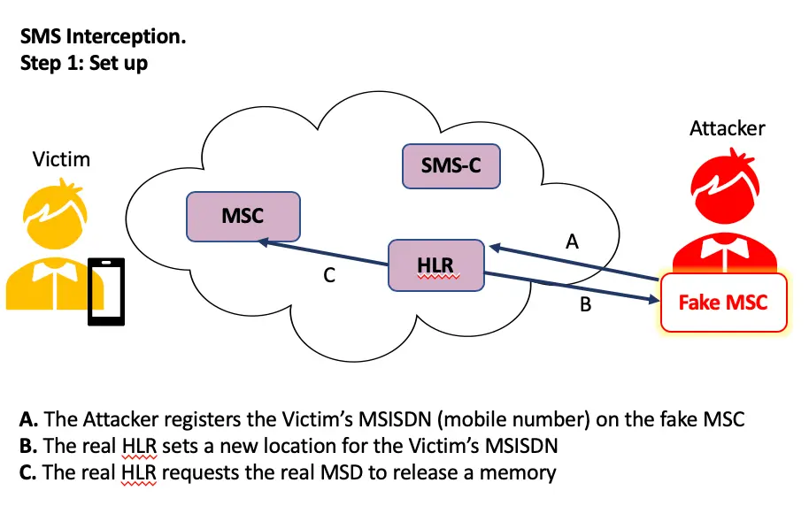
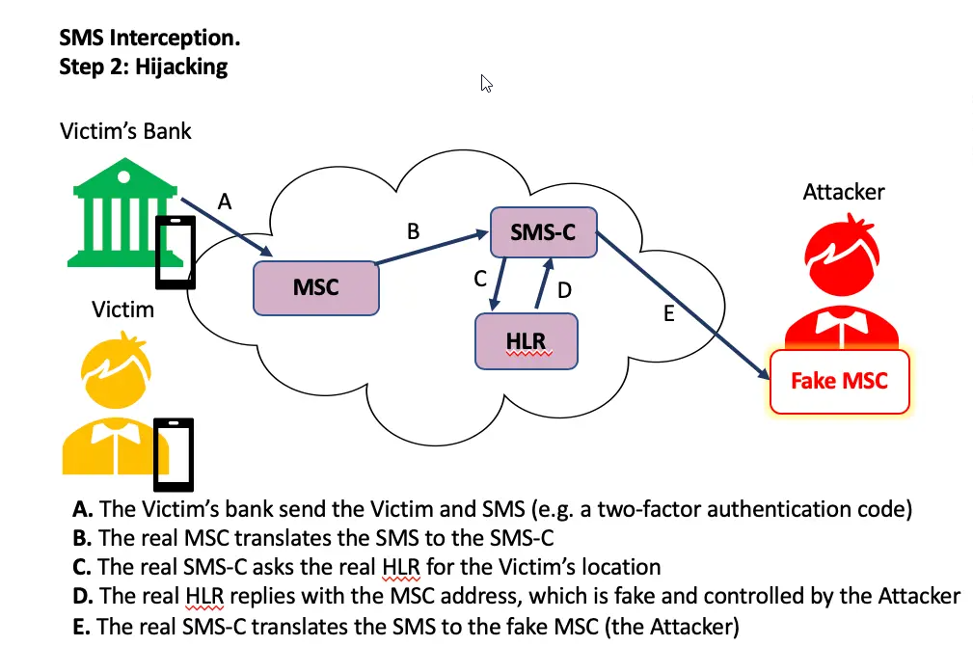
SS7 (Signalling System 7) continued
Unfortunately, highly vulnerable to MiTM type attacks…
Very simple exploits allow attackers to gain access to cell phone locations, eavesdropping on messages and calls
Attacks can easily reset account passwords using intercepted SMS based 2FA

Slide 9
SIM Swapping
Social engineering attack against cell phone carrier
Attacker convinces carrier into switching the victims number to a different device
Attack has control over the device that the victim’s number is now paired with
Used as one step in a larger attack to gain access to social media or bank accounts
Attackers can now reset account passwords via SMS without knowing original passwords

Slide 10
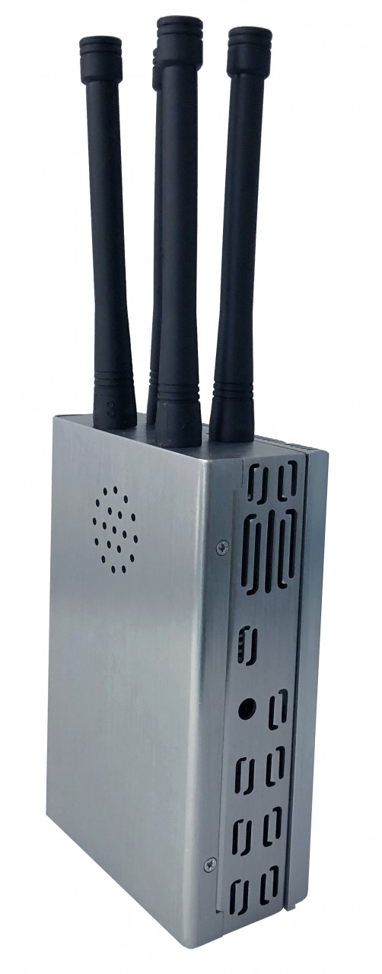
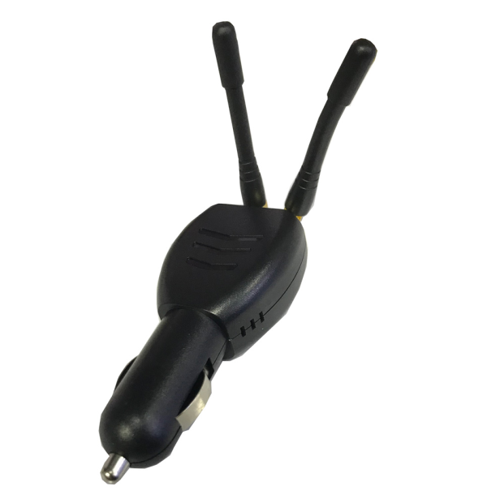
Network/Signal Jamming
Form of DoS attack intended to disrupt a wireless connection
The act of sending “noise” that will target a frequency band to disrupt genuine communications operating on that frequency
Signal jamming devices are relatively easy to access
Highly illegal
GPS Jammer WiFi Jammer

